Slide 1

SYLIP CORPORATION
ANNUAL SALES PERFORMANCE REPORT FROM 2010 - 2017
DATA TYPE: ANNUAL SALES DATA
REPORTING CYCLE: 2010 – 2017
PRESENTED BY:
GROUP 1

Slide 2
GROUP NAME AND TEAM MEMBERS
Samuel Bonsu (Group Leader).

Slide 3
BECNH-MARK
BENCH-MARKS (TARGET) - (ASSUMED VALUED)
Annual Total Cost Target = £1,500,000.00
Annual Total Profit Target = £2,500,000.00
Annual Revenue (Sales) Target = £4,000,000.00
Annual Units Sold (Qty) Target = 15,000

Slide 4
KEY PERFORMANCE INDICATORS
Compute total profit for all regions
Calculate total revenue made annually
Compare total quantity sold year by year for each item type
Rate of total revenue achieved in all regions
Determine the Gross Profit Margin for each item type sold
Average amount of profit achieved annually
Top 4 countries with highest and lowest revenue
Determine revenue growth rate year on year

Slide 5
TERMINOLOGIES
Profit: Profit is the financial gain that a business or individual makes from their activities after deducting all associated costs and expenses.
Revenue: Revenue is the total amount of money a business earns from its normal business activities, such as selling goods, services, or other activities that generate income.
Annually: Annually is something that occurs once a year or in the course of a year.
Gross Profit Margin: Gross profit margin is the percentage of sales income you have left after paying for the stuff you sold
Rate: It is a measure, quantity, or frequency, typically one measured against another quantity or measure.
Average: Other word is mean. Average is the the amount of something divided by the total amount.

Slide 6
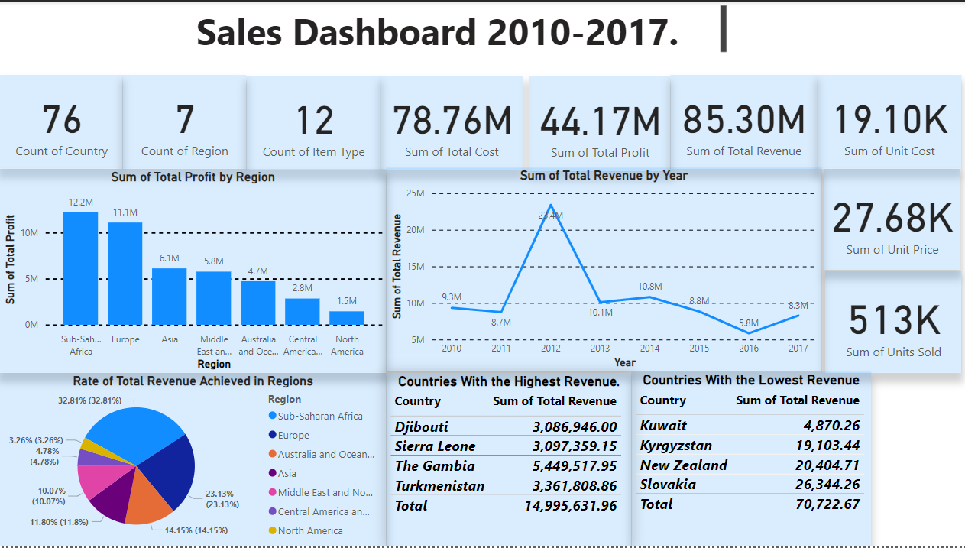

Slide 7
KPI 1: Total Profit from all Regions
iSUMMARY REPORT
From the period under review:
Total profit achieved is
£ 44,168,198.40
Sub-Saharan Africa and Europe are the best regions with greater profit. That is, goods are sold more in these regions. It think this happened because the two regions have many countries in it. (44 countries for Europe and 46 countries for Sub-Saharan Africa.).
The annual total profit target ha been achieved as the profit target is 2,500,000.

Slide 8
KPI 2: Total Revenue achieved Annually.
SUMMARY REPORT
In 20212, 22 items types were sold. As the graph shows. After that there have been fluctuations in the revenue made.
The total revenue achieved is £85,303,514.36
With this, the annual revenue target has been achieved with the target being £4,000,000.

Slide 9
KPI 3: Total Quantity sold Annually for each Item Type.
SUMMARY REPORT
With this graph, beverages were not sold in 2010. Not beverages only.Some of the items were not sold in some years. The item that had the greatest amount sold in all the years except 2011 is cosmetics.

Slide 10
KPI 4: Rate of Total Revenue for Regions.
SUMMARY REPORT
With this graph, the region with the highest rate of revenue is sub-Saharan Africa. This is because many African countries used the item so much that they generate the highest revenue.

Slide 11
KPI 5: Gross Profit Margin for Item Types.
SUMMARY REPORT
The value for the gross profit margin is in percentage. It is the profit made divided by the total revenue then multiplied by 100%.
The gross profit margin indicates that a company is managing its production very well.
High gross profit margin means that a company retains more revenue after direct cost is removed from it. But does not mean the overall profit will be higher.

Slide 12
KPI 6: Average Amount of Profit achieved Annually.
SUMMARY REPORT
There have been fluctuations in the average amount of profit.
The company has demonstrated efforts of maintain g a consistent growth despite its ups and downs.

Slide 13
KPI 7: Top 4 countries with highest and lowest revenue.
SUMMARY REPORT
From the countries with highest revenue, Gambia generated the highest revenue. In population, Sierra Leon has the greatest population. But because the Gambia has a large market size, they generated the highest revenue.
For the countries with the lowest revenue, I cans say that their economy is not good as there are inflation on products and their location also count. They are far away from the company so it makes it difficult to transport the products there.

Slide 14
KPI 8: Revenue Growth rate year by year.
SUMMARY REPORT
This is the rate of growth of revenue year by year. There is a trend with year and revenue. The trend is that, 2012 has the most of everything in relation to revenue. From 2011 where the company had a slight decrease in growth and revenue, it had an increase in 2012. With this, it can be that the company had a money problem or had a decrease in the manufacturing of products or even transporting it.

Slide 15
CONCLUSION.
The sales growth from 2010 to 2017 reveals numerous notable patterns and regional variations. The overall revenue earned throughout 76 nations was $85.30 million, with Sub-Saharan Africa and Europe contributing the most to total profit at $12.2 million and $11.1 million, respectively.
However, total revenue has fallen severely over periods of time, falling from $23.4 million in 2010 to $5.8 million in 2017. This tendency indicates that it is important for strategic research to discover underlying causes such as saturation of the market, ineffective operations, or external financial constraints.
Despite a reduction in total sales, Sub-Saharan Africa had the biggest revenue contribution (32.81%), demonstrating its significant market potential. North and Central America, on the other hand, provided the least in terms of profit and sales, indicating potential markets for growth and investment.

Slide 16
RECOMMENDATION
To address the patterns in sales achievement from 2010 to 2017, a variety of measures can be adopted that will enhance the future outcomes. First, those with excellent performance regions such as Sub-Saharan Africa and Europe need to be promoted. These locations have regularly contributed the most to earnings, making them prime candidates for greater investments in advertising, creation of goods, and consumer engagement. By bolstering operations in these financial markets, the corporation may maintain and perhaps enhance revenue streams.On the contrary hand, lagging regions such as North America and Central America demand additional attention. Doing survey research to uncover difficulties in these sorts of areas—such as little market or inadequate advertising strategies—will aid in the development of specific solutions.
This could involve targeted promotions or strategic alliances to increase sales.
The consistent drop in total earnings from 2010 to 2017 additionally calls for immediate action. Analyzing the causes that contributed to this reduction, such as price tactics or market rivalry, will assist the organization in adapting to changing situations. Diversifying the product line and expanding into new markets may create new prospects for growth. Furthermore, minimizing operational costs will boost profitability while preserving product quality.
Lastly, harnessing insights based on data and increasing advertising efforts will allow the organization to
more effectively adapt to market developments. By leveraging advanced analytics and targeted advertising, the organization may gain a deeper understanding of client requirements and position itself for achievement in established and growing areas.

Slide 17
END

